Slide 1
A note concerning the closest point pair algorithm
Martin Richards
University Computer Laboratory, New Museums Site, Pembroke St., Cambridge CB2 3QG, UK
Information Processing Letters 82 (2002) 193–195

Slide 2
Abstract
An algorithm, described by Sedgewick, finds the distance between the closest pair of n given points in a plane using a variant of mergesort. This takes O(n log n) time. To prove this it is necessary to show that, in the merge phase of the algorithm, no more than a constant number of distances need to be checked for each point considered.

Slide 3
Abstract
Cormen, Leiserson and Rivest show that checking seven distances is sufficient while Sedgewick suggests that this should be four. This paper shows that checking three distances is sufficient and that a slight modification of the algorithm reduces the number to two.

Slide 4
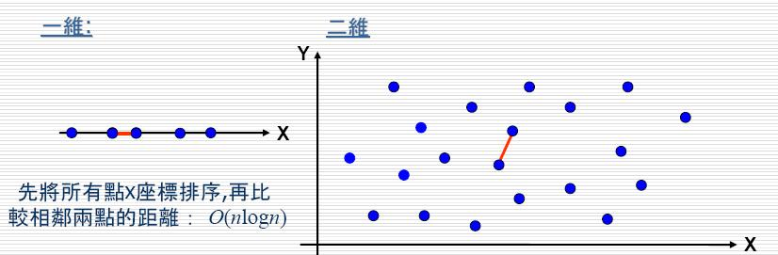
1. The algorithm(1)
Definition: Given a set S of n points, find a pair of points which are closest together.

Slide 5
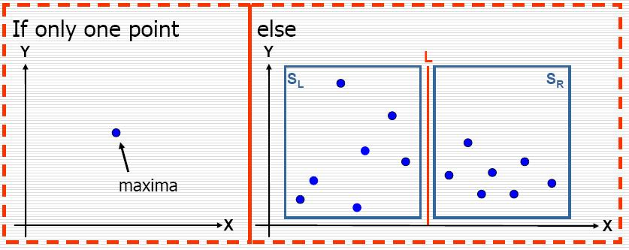
1. The algorithm(2)

Slide 6
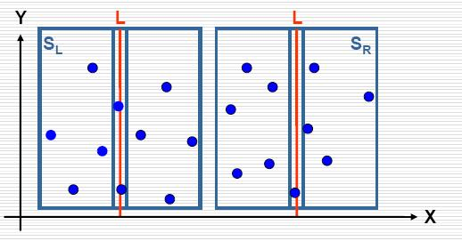
1. The algorithm(3)

Slide 7
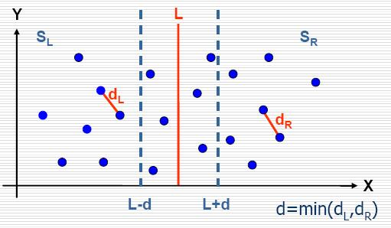
1. The algorithm(4)

Slide 8
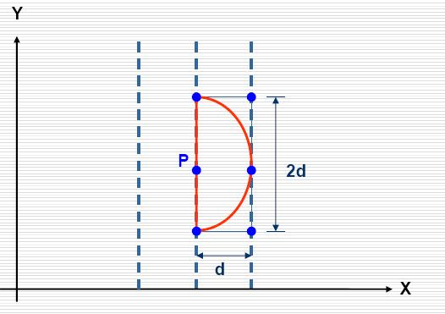
1. The algorithm(5)

Slide 9
1. The algorithm(6)
d

Slide 10
2. Proof (0)
min is the minimum separation distance.
P could potentially be one of a closer pair.
Suppose the next four points on the stack are A, B, C, and Q.
Clearly satisfy P_{y} ≥ A_{y} ≥ B_{y} ≥ C_{y} ≥ Q_{y} .
The algorithm checks whether any of the distances PA, PB or PC are less than min.
If PQ < min then P will be at least as close to one of A, B, or C.

Slide 11
2. Proof (1)
min₀ = d.
Assume P is on the top edge of the left hand square. If PQ < min, Q must be in the right hand square and A, B and C must all be in the rectangle.
P
Dividing line(L)
min₀
Q
min₀

Slide 12
2. Proof (2)
Case (1)
If A, B, C and Q are all in the right hand square.
P
A
B
Q
C

Slide 13
2. Proof (3)
Case (2)
The next case is when just one of A, B or C is in the left hand square.
P
A
B
Q
C

Slide 14
2. Proof (4)
Let that point be renamed Z and the other two renamed X and Y.
P
X
Z
Q
Y

Slide 15
2. Proof (5)
XY = min₀.
Note that RXYQ is a rhombus with sides of length min₀.
Since PQ < min(≤ min₀), P must be to the right of R forcing the PX ≤ PQ.
R
P
X
Z
Q
Y

Slide 16
2. Proof (6)
My approach of proof:
PQ = ( min₀² + b² )^{1/2} .
PX = (min₀ + b) > PQ.
But PQ and PX > min₀ .
b
P
X
Z
Q
Y

Slide 17
2. Proof (7)
If PQ < min₀.
X’X = (min₀² – (min₀-a) ²)^{1/2} = (a(2min₀ - a))^{1/2} .
PL < (a(2min₀ - a))^{1/2} → PX’ < min₀.
P
L
X’
X
min₀-a
min₀-a
Z
Q
a
Y

Slide 18
2. Proof (8)
Case (3)
The next case when two of A, B and C share the left hand square with P.
P
A
B
C
Q

Slide 19
2. Proof (9)
By swapping P and Q and inverting the figure this arrangement can be seen to be equivalent to the previous case and so the same result holds.
P
C
B
Q
A

Slide 20
2. Proof (10)
Case (4)
If A, B and C are in the left square with P.
A
P
B
C
Q

Slide 21
3. Final comments(1)
at least one of A, B or C will be on the same side as P.
P
A
B
C

Slide 22
3. Final comments(2)
A, B, C will all be opposite to P.
P
A
B
C

Slide 23
3. Final comments(3)
The number of checks can be further reduced to two by the observation that only two of PA, PB and PC need be checked, since, either at least one of A, B or C will be on the same side as P, or they will all be opposite to P, in which case PC will be no smaller than PA or PB.

